Slide 1
GATEWAY
GATEWAY Protocol

Slide 2
GATEWAY
A gateway is networking devices. It is used to add two different protocols.
Gateway are type of router. Router connect two or more networks and provides the routing function.
A gateway is a network node used in telecommunication that connects two network with different transmission Protocols together.
Gateway have two types of Protocols –
Interior Gateway Protocol.
Exterior Gateway Protocol.

Slide 3
Interior Gateway Protocols - It is a protocol which is used to find network path information within an Autonomous system.
Exterior Gateway Protocols - It is a protocol which is used to find network path information between different Autonomous systems.
Autonomous System: An autonomous system refers to the compilation of IP networks and routers under the control of one entity.
Or
Autonomous System is a collection of network under single technical administration.

Slide 4
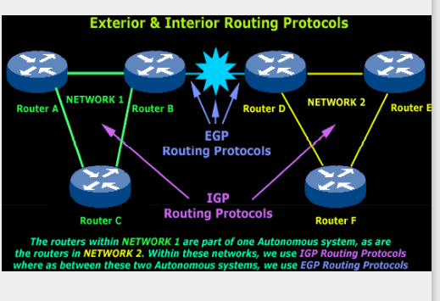

Slide 5
Types of Gateway Protocols:
Routing Information Protocol (RIP).
Open Shortest Path First (OSPF).
Exterior Gateway Protocol (EGP).
Border Gateway Protocol (BGP).
Intermediate System to Intermediate System (IS-IS).

Slide 6
RIP
RIP stands for Routing Information Protocol.
It is an open standard Protocol, it is also known as IP RIP because it easily work with any company Router.
It works on the Application layer of the OSI Model.
It is used in LAN(Local area network) and WAN(wide area network).
It is an Interior gateway protocol, which is decide best route help of Distance vector Algorithm.
It is a dynamic routing Protocol which is find the best route of source to destination medium.

Slide 7
Disadvantages of RIP
RIP is only based on hop count matrix. So If there is better route available with more bandwidth, RIP is not going to choose that particular route.
RIP supports maximum 15 hop count (0-15), so means maximum 16 can be configured in RIP not more than that.
Slow convergence rate. (it means, the time any link goes down it should it should quickly choose an alternate route but in RIP it takes long time).

Slide 8
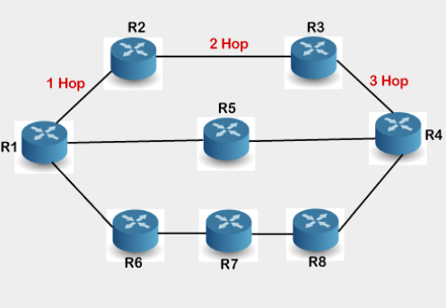

Slide 9
OSPF
OSPF stands for Open Shortest Path First.
It is an internal routing protocol.
It is based on the link state routing.
For the handling the routing efficiently and in a timely manners the OSPF divides an AS into areas.
It is an Interior Gateway Protocol.
Unlimited hop count.
It use Dijkstra’s Algorithm(i.e. it is find a shortest path to reach the destination).

Slide 10
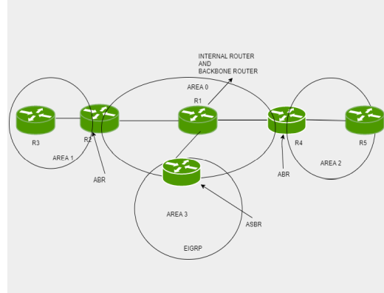

Slide 11
EGP
Exterior Gateway Protocol or EGP is a protocol that is used to exchange data between gateway hosts that neighbor each other within autonomous systems.
In other words, EGP provides a forum for routers to share information across different domains.

Slide 12
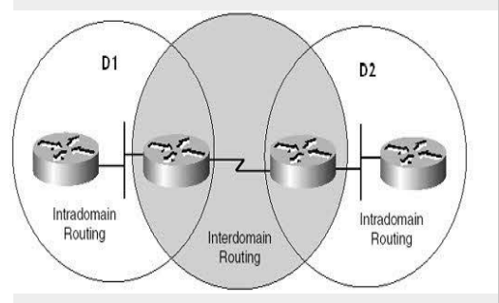

Slide 13
BGP
BGP stands for Border Gateway Protocol.
BGP is used between different Autonomous System.
It is an exterior routing protocol.
It is based on the path vector routing(contain a table: destination network, next router, path).
BGP is application layer Protocol uses TCP for reliability, TCP Port 179.
Slowest Routing Protocol.
BGP Administrative Distance :
IBGP(Interior Border Gateway Protocol [200 internals]).
EBGP(Exterior Border Gateway Protocol [ 20 externals]).

Slide 14
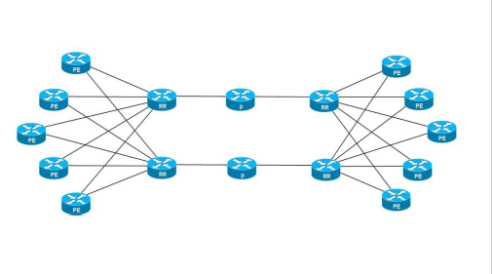
Works of BGP
When BGP neighbours first established a connection they exchange all candit BGP routes. After this initial exchange incremental update are sent as network information change.

Slide 15
IS-IS
IS-IS stands for Intermediate system to intermediate system.
Intermediate System-to-Intermediate System (IS-IS) is a link-state, IP routing protocol and IGP protocol used on the internet to send IP routing information.
IS-IS is a routing protocol designed to move information efficiently within a computer network, a group of physically connected computers or similar devices. It accomplishes this by determining the best route for data through a packet switching network.
An IS-IS network consists of a range of components including end systems, (user devices), intermediate systems (routers), areas, and domains.

Slide 16
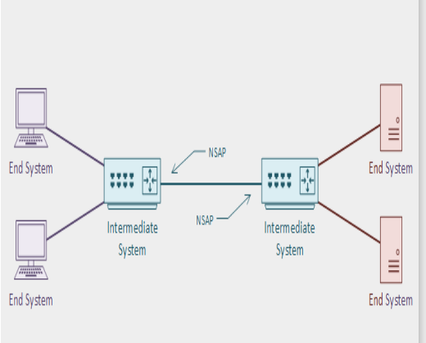

Slide 17
Thank you!!

